Slide 1
LECTURE # 12
TREE

Slide 2
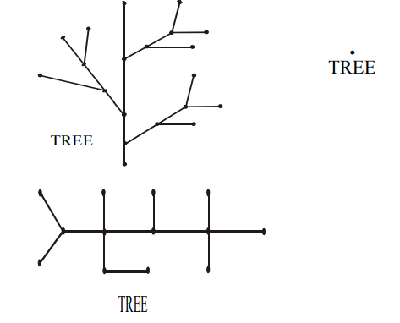
TREES APPLICATION AREAS:
Trees are used to solve problems in a wide variety of disciplines. In computer science trees are employed to
construct efficient algorithms for locating items in a list.
construct networks with the least expensive set of telephone lines linking distributed computers.
construct efficient codes for storing and transmitting data.
model procedures that are carried out using a sequence of decisions, which are valuable in the study of sorting algorithms.
TREE:
A tree is a connected graph that does not contain any non-trivial circuit. (i.e. it is circuit free).
A trivial circuit is one that consists of a single vertex.
Examples of tree are

Slide 3
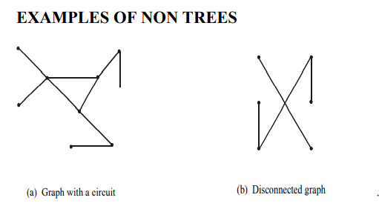
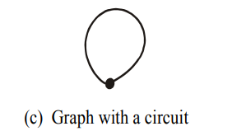
there exists circuit, so not a tree
there exists no connectedness, so not a tree.
there exists a circuit (also due to loop), so not a tree (because trees have to be a circuit free).

Slide 4
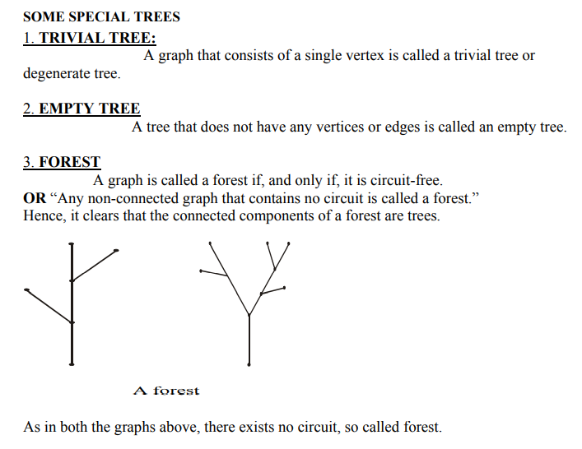

Slide 5
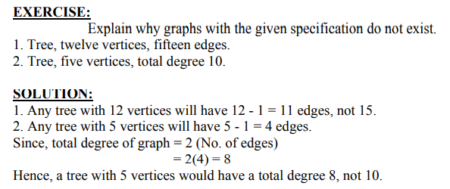
PROPERTIES OF TREES:
Theorem 7.2.3
If T is a graph with n vertices, the following are equivalent:
a) T is a tree
b) T is connected and acyclic
(“acyclic” = having no cycles)
c) T is connected and has n-1 edges
d) T is acyclic and has n-1 edges
Practice question

Slide 6
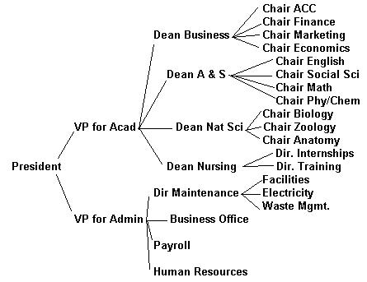
Example : Tree Organizational charts

Slide 7
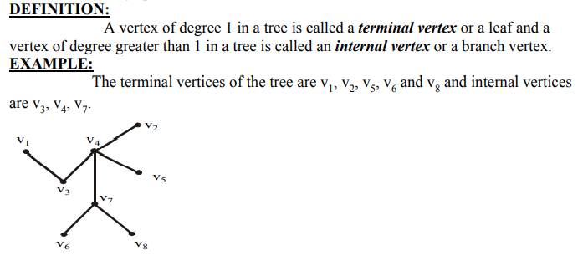

Slide 8
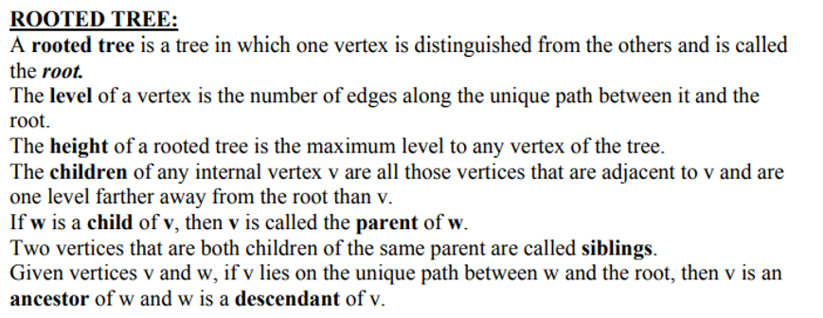
A node's "uncles" are siblings of that node's parent.
A node that is connected to all lower-level nodes is called an "ancestor". The connected lower-level nodes are "descendants" of the ancestor node.

Slide 9
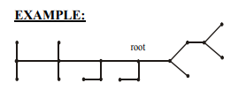
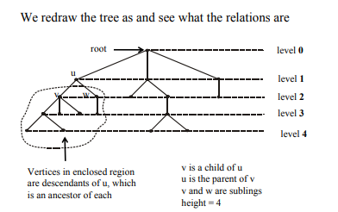
Practice question

Slide 10
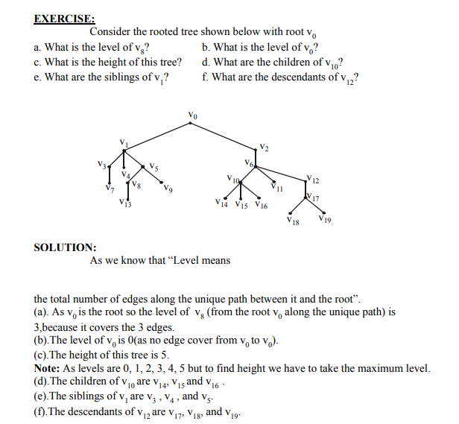
Practice question

Slide 11
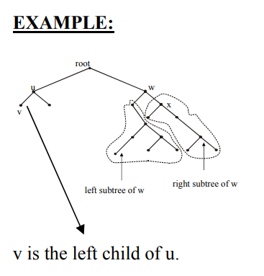
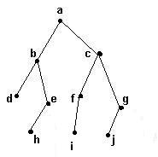
Binary trees
A binary tree is a tree where each vertex has zero, one or two children

Slide 12
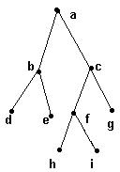
Full binary tree
A full binary tree is a binary tree in which each vertex has two or no children.

Slide 13
Full binary tree
Practice question
Theorem 7.5.4: If T is a full binary tree with k internal vertices, then
T has k + 1 terminal vertices and
the total number of vertices is 2k + 1.
Example:
there are k = 4 internal vertices (a, b, c and f) and 5 terminal vertices (d, e, g, h and i) for a
total of 9 vertices.
2(4) + 1.

